Slide 1
Digital Signal Processing Applications T.E Comp (2012 Course) Sem II

Slide 2
Digital Signal Processing
Digital :
Operating by the use of discrete signals to represent data in the form of numbers
Signal :
A variable parameter by which information is conveyed through an electronic circuit
Processing :
To perform operations on data according to programmed instructions

Slide 3
UNIT I
Breadth & Depth Of DSP , Statistics , Probability & noise.
Use of Transducers in Signal Processing, How Digital signal is created-ADC & DAC.
Signal, Signal Modeling, Signal Representation ,Operations on signals.
Classification Of Signals- Part1
Classification Of Signals- Part2
Properties Of Discrete Time Systems.
Mathematical models for representation of DT system: Linear convolution.
Linear constant coefficient difference equation

Slide 4
SESSION 1
Signal & Signal Characteristics
Reasons For Signal Processing
Block Diagram Of Digital Signal Processing
Analog Signal Processing
Transducers
Advantages Of Digital Signal Processing over analog signal Processing.

Slide 5
Signal & Signal Characteristics
Signal is a detectable or measurable Physical quantity or impulse by which messages or information can be transmitted
Signal Characteristics
Signals are Physical Quantities
Signals are measurable
Signals Contain information

Slide 6
Examples Of Signals
Speech is encountered in Telephony, Radio & everyday life
Biomedical Signals (heart signals, Brain signals)
Sound & Music as reproduced by CD Player
Video & Image
Radar Signals which are used to determine distant Targets

Slide 7
Reasons For Signal Processing
Extract information about the signal (Amplitute,Phase,frequency,Spectral content,Timing relationship)
Reformat the signal (CDMA,TDMA,FDMA,Telephony)
Compress Data( Modems,Cellular Telephones)
Generate feedback Control Signal (Feedback Control System)
Extract Signal from noise (Filtering)
Capture & store signal in digital format for analysis (FFT)

Slide 8
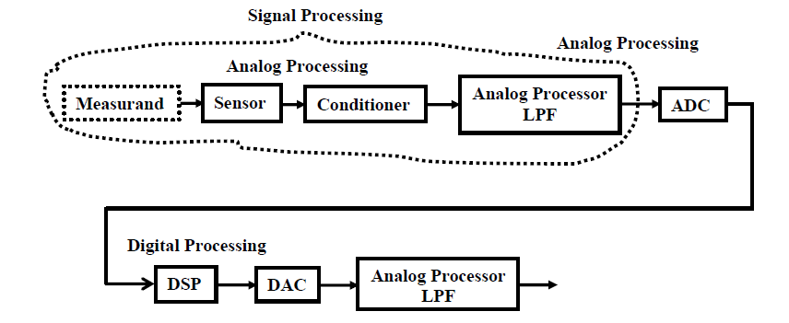
Block Diagram of DSP

Slide 9
Analog Signal Processing Components
Measurand- Physical Quantity to be measured
Transducers – Converts Physical Variable into electrical signal
Signal Conditioner – Prepare sensor output for further signal Processing
Low Pass Filter – Reduces Noise. It Consist of Resistor, Inductor, Capacitor.

Slide 10
Analog signal Processing
Analog Signal Processing is signal Processing conducted on analog signals by analog means.
Analog means something that is mathematically indicated as continuous values
Digital uses series of Discrete quantities to represent signal
Analog Values are typically indicated as voltage or current around components in electronic devices

Slide 11
Transducers
Transducers Convert physical Quantity into Electrical Signal
Analog & Digital Transducers
Analog Transducers produce output in the form of Analog that is changing continuously with time
Digital Transducers Produce output in terms of discrete digital output signal

Slide 12
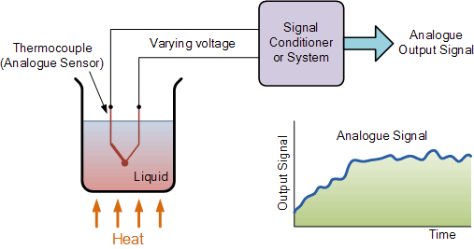
Example of Temperature Transducer to produce Analog output

Slide 13
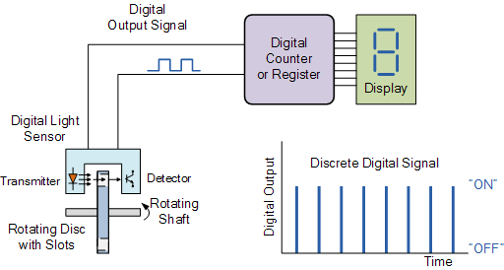
Light Sensor used to produce Digital Signal

Slide 14
Drawbacks Of Analog Signal Processing
Sensitive to environmental changes
Ageing
Less Accuracy
Cost of system is High

Slide 15
DSP Applications
Audio Signal Processing ,Audio Compression
Digital Image Processing ,Video Compression
Speech Processing , Speech Recognition
Digital Communication
Radar
Sonar
Seismology
Biomedical Application

Slide 16
Session 2
ADC & DAC-
Sampling
Quantization
Encoding
Statistics, Probability & noise

Slide 17
Analog TO Digital Converter
Analog Signals that are digitized by ADC normally come from sensors or transducers that capture a signal & transform it into voltage that is proportional to the amplitude
of the signal
The operation required to convert voltage generated by Sensor into its Digital equivalent is a two stage process- Sampling & quantization

Slide 18
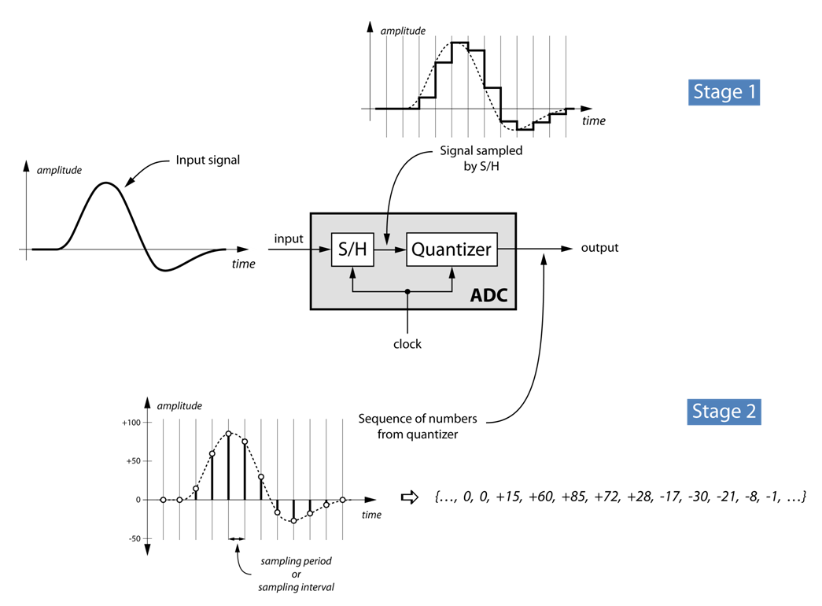
Analog TO Digital Conversion Process

Slide 19
A TO D Conversion Process
Sampling- Conversion Of Analog Signal into Discrete signal By taking sample every Ts
Quantization- Conversion Of Discrete signal into discrete signals with discrete values.
Value Of each sample is represented by Value selected from finite set of possible Values.
Encoding- It is the process of assigning each
Quantization level a unique binary code of b bits

Slide 20
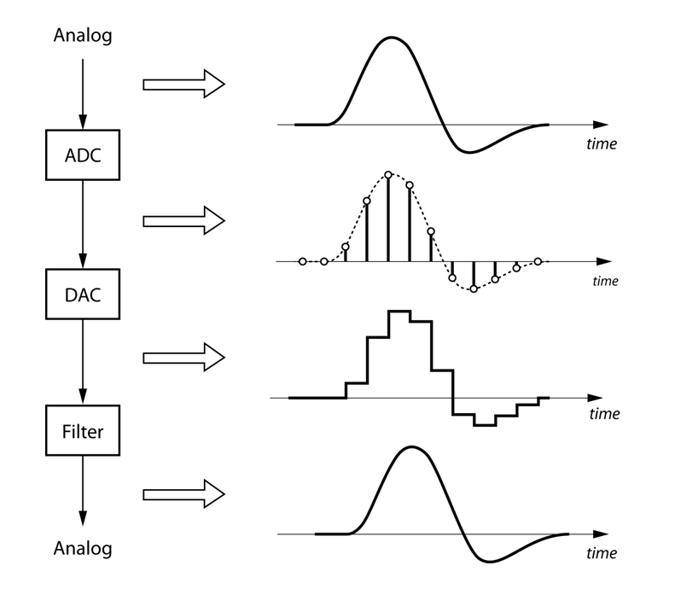
ADC & DAC outputs

Slide 21
Sampling
A TO D Converter is used to convert x(t) into x[n]
Take a sample every sampling period T_{S}

Slide 22
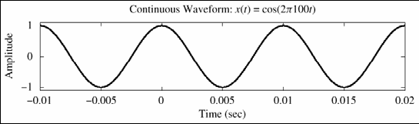
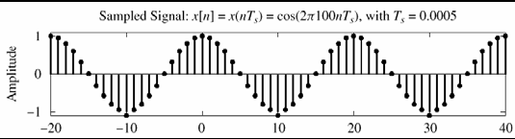
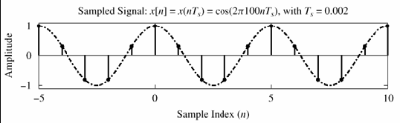
Sampling

Slide 23
Sampling Theorem Statement A continuous-time signal x(t) with frequencies no higher than fmax (Hz) can be reconstructed exactly from its samples x[n] = x(nTs), if the samples are taken at a rate fs = 1/Ts that is greater than 2fmax.

Slide 24
Poor Sampling
Sampling Frequency = 1/2 X Wave Frequency

Slide 25
Even Worse
Sampling Frequency = 1/3 X Wave Frequency

Slide 26
Higher Sampling Frequency
Sampling Frequency = 2/3 Wave Frequency

Slide 27
Getting Better
Sampling Frequency = Wave Frequency

Slide 28
Good Sampling
Sampling Frequency = 2 X Wave Frequency

Slide 29
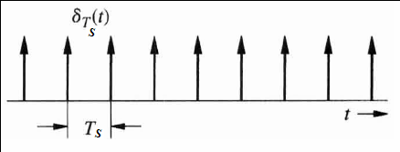
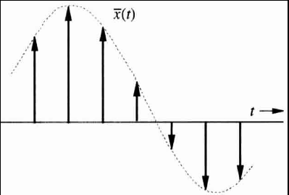
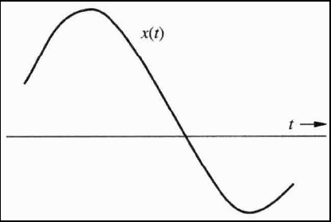
Sampling-means multiplying it with train of impulses
X

Slide 30
Statistics, Probability & noise
Statistics & Probability are used in DSP to characterize signals & processes that generate them.
Primary use of DSP is to reduce interference ,noise & undesirable components in acquired data. These are the inherent part of signal being measured that arise from imperfections in Data Acquisition system. Statistics & Probability allow these features to be measured & classified

Slide 31


Mean and Weighted Average
Standard Deviation

Slide 32
Session 3
Signals
Signal Modeling
Signal Representation
Operations On Signals

Slide 33
Signal Modeling
The Representation Of Signal by mathematical expression is Known as Signal Modelling. If one can represent a signal by mathematical equation then signal is said to be deterministic
Signal.
If we are not able to represent a signal by mathematical form then signal is called random Signal

Slide 34
Fundamentals Of Signals
Dependent Variables
Independent Variables

Slide 35
Fundamentals:
a. The Dependent Variable:
A signal can be described by a function of one or more dependent variables.
The dependent variable can be:
1- real valued scalar quantity,
2- a complex valued quantity,
3- or a vector (multi-channel).

Slide 36

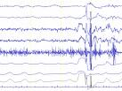
Fundamentals: a. The Dependent Variable:
Example of a multi channel signal is the EEG: electroencephalography
12 lead EEG ( input)
Result 12 channel signal( output)

Slide 37
Fundamentals: b. The Independent Variable:
Signals can be functions of single or multiple independent variables.
A speech signal is function of single independent variable, particularly time s(t)
An Image signal is function of two independent variables M(x,y)
TV signal is function of 3 independent variables I (x,y,t)

Slide 38
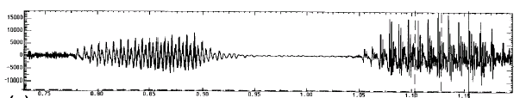
Fundamentals
b. The Independent Variable:
1. One dimensional signal: (speech)
t

Slide 39
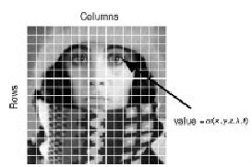
2. Two dimensional signal (Image)
Fundamentals
b. The Independent Variable:
pixels
y
f(x,y) =110
x

Slide 40
Fundamentals:
b. The Independent Variable:
3. Three dimensional signal: Coloured TV signal is function of 3 independent variables for 3 colours
I_{R} (x,y,t) - I_{G} (x,y,t) I_{B} (x,y,t)
Coloured TV is a 3-channel , 3-dimensional signal

Slide 41
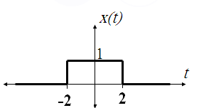
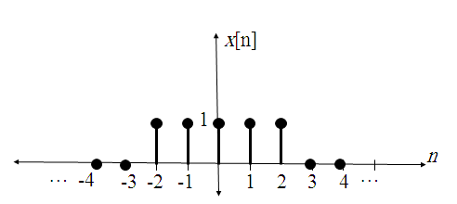
Types of Signals
Continuous-time (CT)
x(t), t is real.
Discrete-time (DT)
x[n], n is integer.

Slide 42
Types of Signals:
Continuous-time signals (CT) or Analog signals:
Are defined for every value of time and they take on values in the continuous interval (a,b) where a can be –∞ and b can ∞

Slide 43
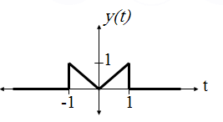
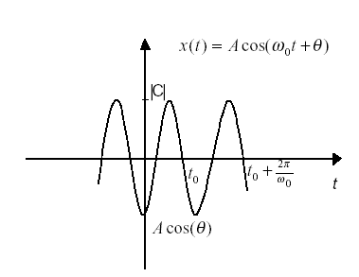
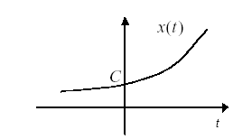
Types of Signals:
Examples of Continuous-time signals (CT) or Analog signals:

Slide 44
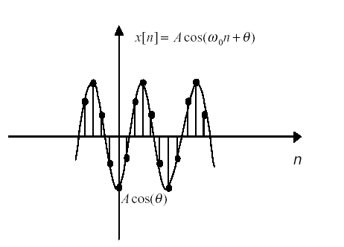
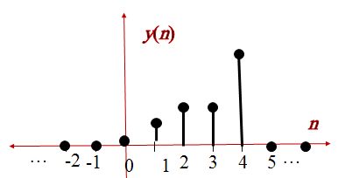
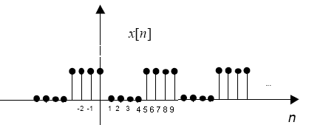
Types of Signals:
Examples of Discrete-time Signals (DT)

Slide 45

Signals Representation
Signals can be represented in a mathematical form:
x(t) = e^{t},
y(t) =
x[n] = n/2
Discrete signals can also be represented as sequences:
y[n] = {…,1,0,1,0,1,0,1,0,1,0,…}
or in a tabular form

Slide 46
Operations of Signals
Sometime a given mathematical function may completely describe a signal .
Different operations are required for different purposes of arbitrary signals.
The operations on signals can be
Time Shifting
Time Scaling
Time Inversion or Time Folding

Slide 47
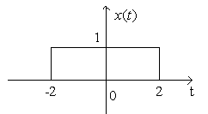
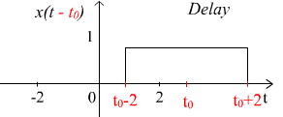
Time Shifting
The original signal x(t) is shifted by an amount tₒ.
X(t)→X(t-to) →Signal Delayed→ Shift to the right

Slide 48
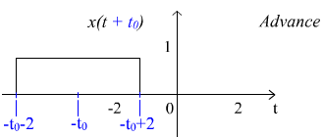
Time Shifting Contd.
X(t)→X(t+to) →Signal Advanced→ Shift to the left

Slide 49
Time Scaling
For the given function x(t), x(at) is the time scaled version of x(t)
For a ˃ 1,period of function x(t) reduces and function speeds up. Graph of the function shrinks.
For a ˂ 1, the period of the x(t) increases and the function slows down. Graph of the function expands.

Slide 50
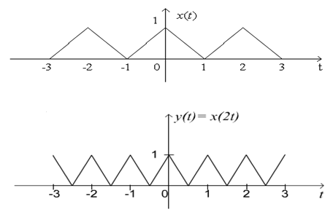
Time scaling Contd.
Example: Given x(t) and we are to find y(t) = x(2t).
The period of x(t) is 2 and the period of y(t) is 1,
Notes:
Example: fast forwarding / slow playing

Slide 51
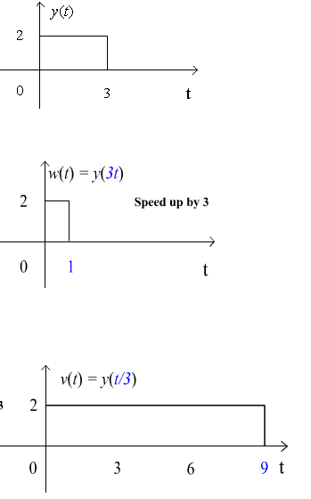
Time scaling Contd.
Given y(t),
find w(t) = y(3t)
and v(t) = y(t/3).

Slide 52
Time Reversal
Time reversal is also called time folding
In Time reversal signal is reversed with respect to time i.e.
y(t) = x(-t) is obtained for the given function

Slide 53
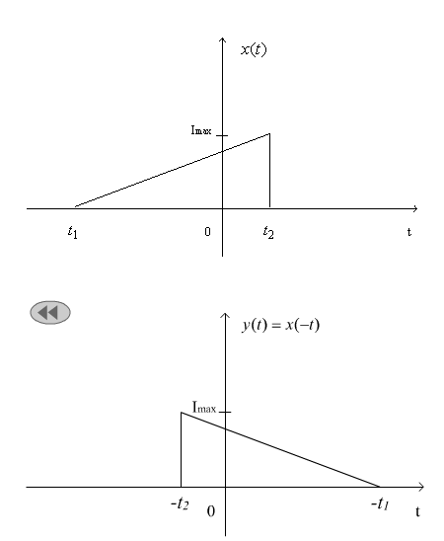
Time reversal Contd.
Notes:
Example: Playing a tape recorder backward
Beatle Revolution 9 is said be played backward!

Slide 54
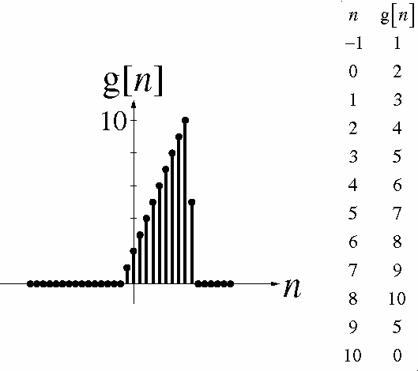
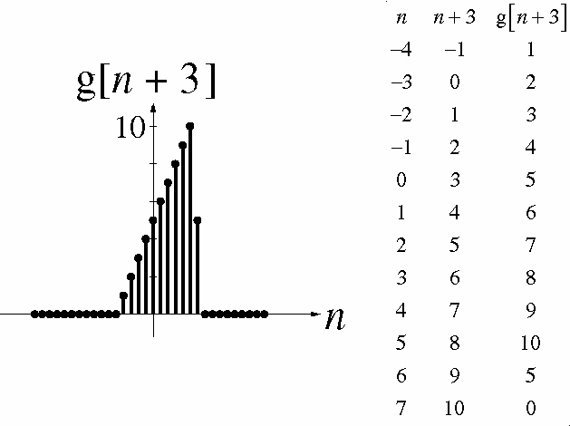
Operations of Discrete Time Functions

Slide 55
Session 4 & 5
Classification Of Signals

Slide 56
Signals Classifications
CT signals and DT Signals can be:
Deterministic or Random
Periodic or a periodic
Real or complex
Causal or non-causal
Even or Odd
Power or Energy Signals

Slide 57
Signals Classifications
Deterministic signals
Deterministic signals can be described by explicit mathematical expression, a table of data or a well defined rule.
All past, present and future values of the signal are known precisely without any uncertainty.

Slide 58
Signals Classifications
2. Random signals (stochastic)
Random signals either can not be described to any reasonable degree of accuracy by explicit mathematical formula, or such a description is too complicated to be of any practical use.
These signals evolve in time in unpredictable manner
Analysis and description of random signals needs statistical techniques instead of explicit formulas.

Slide 59

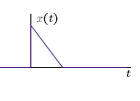
Periodic and aperiodic signals a) For Continuous-time signals
Periodic signals have the property that
x(t + T) = x(t) for all t.
The smallest value of T that satisfies the definition is called the period.
an a periodic signal a periodic

Slide 60
Periodic and aperiodic signals a) For Continuous-time signals
Periodic signals have the property that
x(t + T) = x(t) for all t.
The smallest value of T that satisfies the definition is called the period.
an a periodic signal a periodic

Slide 61
Periodic and aperiodic signals (cont)
If T is the period of x(t), then x(t) = x(t+mT) where m=0,1,2…
The fundamental Period:
The fundamental period T₀ of x(t) is the smallest possible value of T.

Slide 62
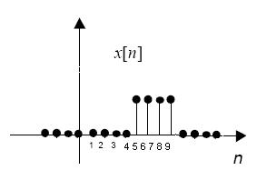
Periodic and aperiodic signals (cont) b) For Discrete-time signals
Periodic signals have the property that
x[n+N] = x[n] for all n.
N
an a periodic signal a periodic

Slide 63
Example
Periodic and aperiodic signals (cont)
Discrete-time signal x [n]= 1 is periodic with fundamental period N = 1

Slide 64
Signals Classifications
Continuous-time
Discrete-time
Real signals
Complex signals

Slide 65
Real and complex signals
Signals can be real, imaginary, or complex. An important class of signals are the complex exponentials:
the CT signal x(t) = e^{st} where s is a complex number,
the DT signal x[n] = z ^{n} where z is a complex number.

Slide 66
Signals Classifications
Continuous-time
Discrete-time
Causal signals
Non causal signals
Anti causal signals

Slide 67

Causal and non-causal signals a) CT signals
A causal Signal is zero for t <0,
A non-causal signal has
a value for t<0 and t>0
An anti-causal signal
is zero for t >0

Slide 68
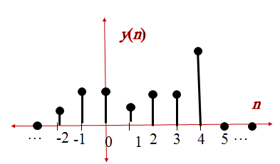
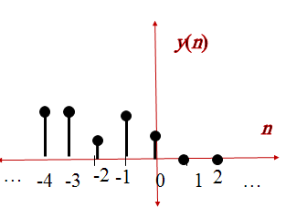
Causal and non-causal signals b) DT signals
A causal Signal is zero
for n <0,
A non-causal signal has
a value for n<0 and n>0
An anti-causal signal
is zero for n>0

Slide 69
Signals Classifications
Continuous-time
Discrete-time
Bounded signals
unbounded signals

Slide 70
Bounded and Unbounded signals

Slide 71
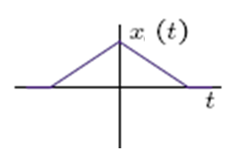
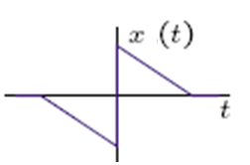
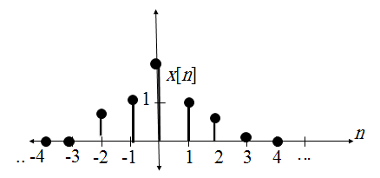
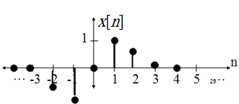
Even and Odd Signals
CT signals
x(t) is even, if x(t)=x(-t)
x(t) is odd, if x(t)= -x(-t)
DT signals
x[n] is even, if x[n]=x[-n]
x[n] is odd, if x[n]=-x[-n]

Slide 72
Even and Odd Signals (cont)
The even part of any signal is:
Ev {x(t)} = (x(t)+x(-t))/2
Ev {x[n]} = (x[n]+x[-n])/2
The odd part of any signal is:
Od {x(t)} = (x(t)-x(-t))/2
Od {x[n]} = (x[n]-x[-n])/2

Slide 73
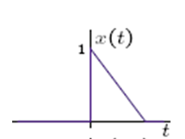
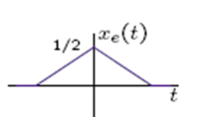
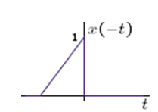
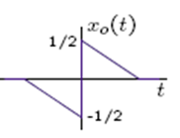
Even and Odd Signals (cont)

Slide 74
Signals Classifications
Continuous-time
Discrete-time
Energy signals
Power signals

Slide 75
Power and Energy Signals
Energy signal iff 0<E<∞, and so P=0.
examples:
Power signal iff 0<P<∞, and so E=∞.
example:
Neither energy nor power, when both E and P are infinite.

Slide 76
Power and Energy of Signals
The energy of a signal is the accumulation of absolute value of the signal

Slide 77
Power and Energy of Signals
The Power of a signal is the average of absolute value of the signal

Slide 78
Power and Energy of Signals
The Power of a signal is the average of absolute value of the signal

Slide 79
Session 6
Linear Systems
Properties Of Discrete Time System

Slide 80
Discrete-Time System
Discrete-Time System is a transformation or operator that maps input sequence x[n] into a unique y[n]
y[n]=T{x[n]}, x[n], y[n]: discrete-time signal
x[n]
T{‧}
y[n]
Discrete-Time System

Slide 81
Properties of Discrete-time systems Memory less (memory) system
Memory less systems:
the output y[n] at every value of n depends only on the input x[n] at the same value of n

Slide 82
Properties of Discrete-time systems Linear Systems
If
T{‧}
T{‧}
and only If:
T{‧}
additivity property
T{‧}
homogeneity or scaling property
principle of superposition
T{‧}

Slide 83
Nonlinear Systems
For
counterexample
For
counterexample

Slide 84
Properties of Discrete-time systems Time-Invariant Systems
Shift-Invariant Systems
T{‧}
T{‧}

Slide 85
Properties of Discrete-time systems causality
A system is causal if, for every choice of , the output sequence value at the index depends only on the input sequence value for

Slide 86
Example for Causal System
Forward difference system is not Causal
Backward difference system is Causal

Slide 87
Properties of Discrete-time systems Stability
Bounded-Input Bounded-Output (BIBO) Stability: every bounded input sequence produces a bounded output sequence.
if
then

Slide 88
Test for Stability or Instability
is stable
if
then

Slide 89
Linear Time-Invariant (LTI) Systems
Impulse response
T{‧}
T{‧}

Slide 90
Session 7 & 8
Mathematical Models for representation Of DT System
Linear Convolution
Linear Constant Coefficient Difference Equation

Slide 91
Linear Time Invariant Systems
Definitions
A linear system may be defined as one which obeys the Principle of Superposition, which may be stated as follows:
If an input consisting the sum of a number of signals is applied to a linear system, then the output is the sum, or superposition, of the system’s responses to each signal considered separately.
A time-invariant system is one whose properties do not vary with time. The only effect of a time-shift on an input signal to the system is a corresponding time-shift in its output.
A causal system is one if the output signal depends only on present and/or previous values of the input. In other words all real time systems must be causal; but if data were stored and subsequently processed at a later date, it need not be causal.

Slide 92
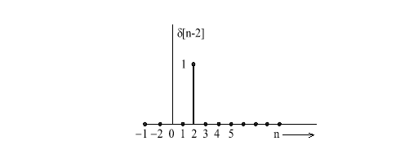
The Unit Impulse Response
The unit impulse is a single vertical line of zero width and a height of 1.
This is also sometimes known as the delta function
d[n] is the symbol given to the line where d means infinitely small.
n is the sampling period
A shifted impulse such as d[n – 2] is the line shifted to the right 2 sampling periods.
n |  | -2 | -1 | 0 | 1 | 2 | 3 | 4 | 5 | 6
δ[n] | 0 | 0 | 0 | 1 | 0 | 0 | 0 | 0 | 0 | 0 | 0
δ[n-2] | 0 | 0 | 0 | 0 | 0 | 1 | 0 | 0 | 0 | 0 | 0

Slide 93
Now consider the following signal:
x[n] = 2d[n ] + 4d[n – 1] + 6d[n – 2] + 4d[n – 3] + 2d[n – 4]
n |  | -2 | -1 | 0 | 1 | 2 | 3 | 4 | 5 | 6
2δ[n] | 0 | 0 | 0 | 2 | 0 | 0 | 0 | 0 | 0 | 0 | 0
4δ[n-1] | 0 | 0 | 0 | 0 | 4 | 0 | 0 | 0 | 0 | 0 | 0
6δ[n-2] | 0 | 0 | 0 | 0 | 0 | 6 | 0 | 0 | 0 | 0 | 0
4δ[n-3] | 0 | 0 | 0 | 0 | 0 | 0 | 4 | 0 | 0 | 0 | 0
2δ[n-4] | 0 | 0 | 0 | 0 | 0 | 0 | 0 | 2 | 0 | 0 | 0
X[n] | 0 | 0 | 0 | 2 | 4 | 6 | 4 | 2 | 0 | 0 | 0
Hence any sequence can be represented by the equation:
= + x[-1]δ[n + 1] + x[0]δ[n] + x[1]δ[n - 1] + x[2]δ[n - 2] +…….
x[k] is the height of each impulse, frequently known as the coefficient.
d [n - k] is the time slot

Slide 94
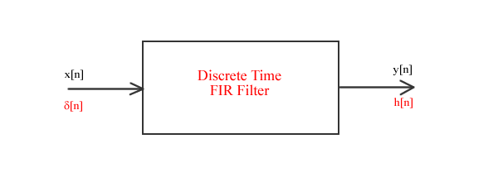

Impulse Response
When the input to an FIR filter is a unit impulse sequence, x[n] = d[n], the output is known as the unit impulse response, which is normally donated as h[n].
A single impulse input yields the system’s impulse response

Slide 95
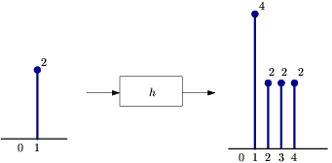
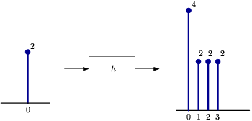
A scaled impulse input yields a scaled response, due to the scaling property of the system's linearity.

Slide 96
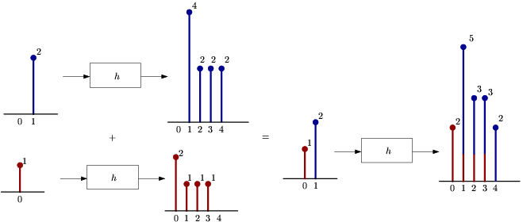
This now demonstrates the additivity portion of the linearity property of the system to complete the picture. Since any discrete-time signal is just a sum of scaled and shifted discrete-time impulses, we can find the output from knowing the input and the impulse response.

Slide 97
Description of LTI discrete systems via difference equations
• This is an implicit specification of the system
– Difference equations describe a relationship between the input and the output
rather than an explicit expression for the system output as a function of its input
- For finding this explicit expression, we must solve the differential equation
- To find a solution, we need more information than provided by the differential equation alone
- This information is specified by auxiliary conditions.

Slide 98
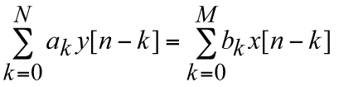
General formula
• A linear constant-coefficient difference equation of order N looks like:
• All solutions y[n] can be expressed as a sum yh[n]+yp[n]

Slide 99


Difference equation rewritten
can be rewritten as:
We need to know the input for all n as well as a set of N
auxiliary conditions such as y[-N], y[-N+1], ..., y[-1] in order to be able to solve the equation

Slide 100
Upon completion Students will be able to: -
Understand the use and applications of DSP technology in different areas.
Applying Statistics & probability to reduce noise & interference in acquired data.
Analyzing analog-to-digital conversion (ADC) and digital-to-analog conversion.
Apply different mathematical rules to linear system to analyze the signal and system.
Evaluating third signal by combining two signals using convolution.
Understand the characteristics of linear systems.

